Slide 1

Captcha if you can
AI review for Ironhack
XXVIII VI MMXXIII

Slide 2
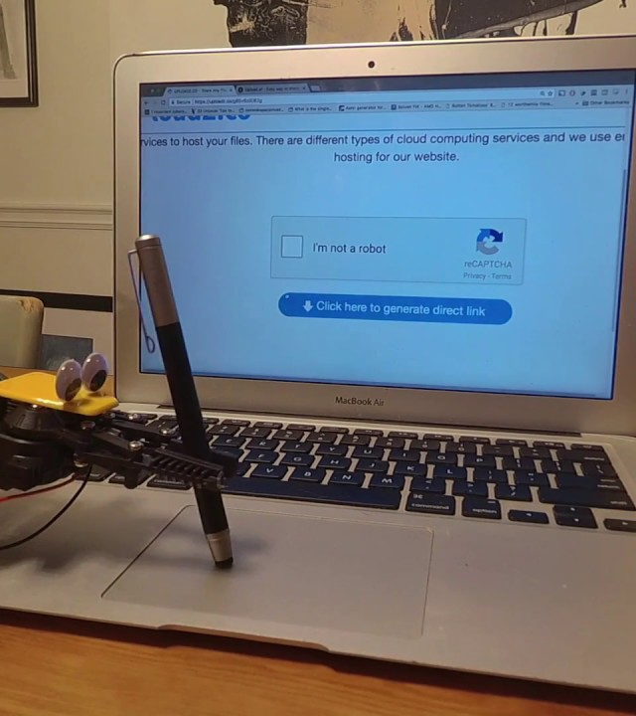
Captcha (Completely Automated Public Turing test to tell Computers and Humans Apart)
Let’s Dive In

Slide 3
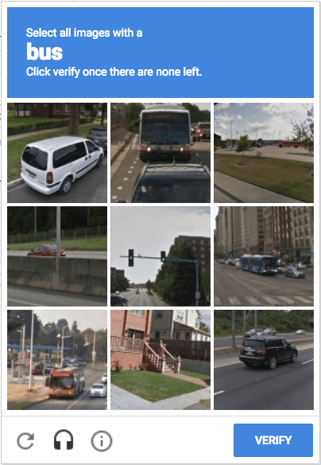
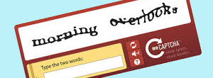
Then and now
Carnegie Mellon University in Pittsburgh
Google
Started as a collaboration of computer scientist
First release in 2007
Just words
Picked up by Google in 2009
Pictures added
One of the goals is to train AI

Slide 4
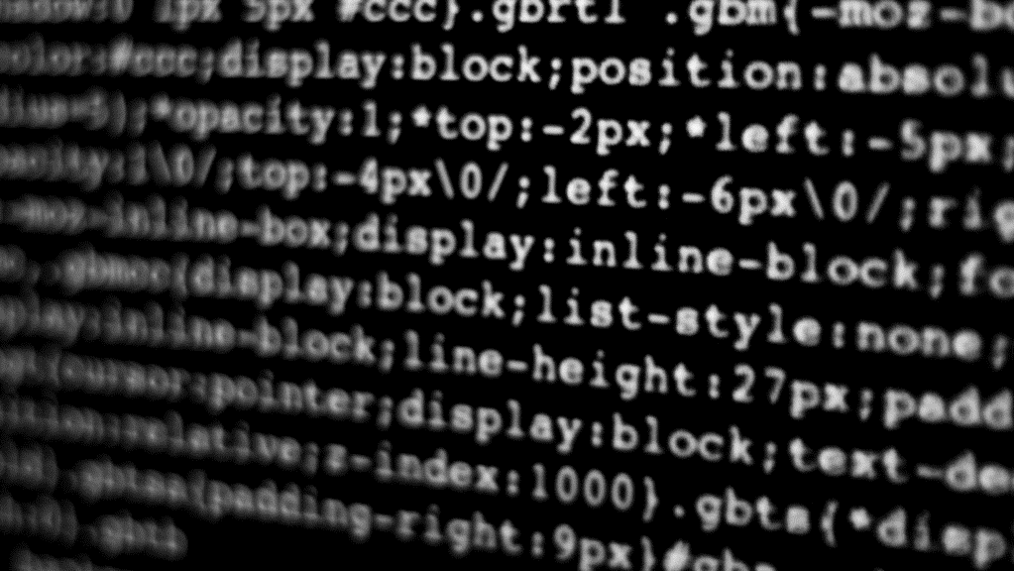
https://www.google.com/recaptcha/about/
reCAPTCHA uses an advanced risk analysis engine and adaptive challenges to keep malicious software from engaging in abusive activities on your website.
reCaptcha predicts the likelihood that the request was generated by a bot

Slide 5
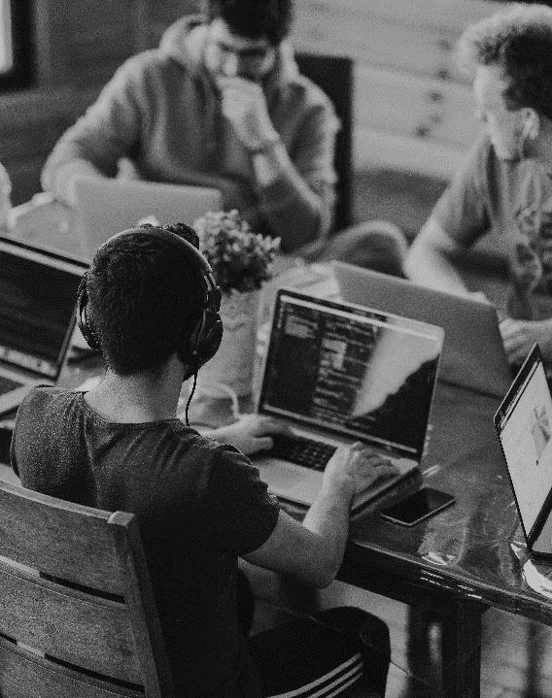
Recaptcha examples
Interaction and usage
Recaptcha’s come in text and images
Used to transcribe books and recognize images
“by 2011 Recaptcha had finished digitising the entire Google Books archive - as well as 13 million articles from the New York Times back-catalogue dating back to 1851” (source:techradar.com)
By solving reCAPTCHA you are enabling the future of autonomous driving and a well- organized google photo’s folder

Slide 6
Captcha & AI
Model usage
How does Google use CAPTCHAs to train AI?
>Google uses a machine learning technique called supervised learning to train its AI.
But how does Google get all those labeled examples?
>You are essentially labeling an image or a piece of text for Google.
AI versus AI
Privacy issues, reCAPTCHA v3.

Slide 7

Thank you
A presentation by a human

